Slide 1

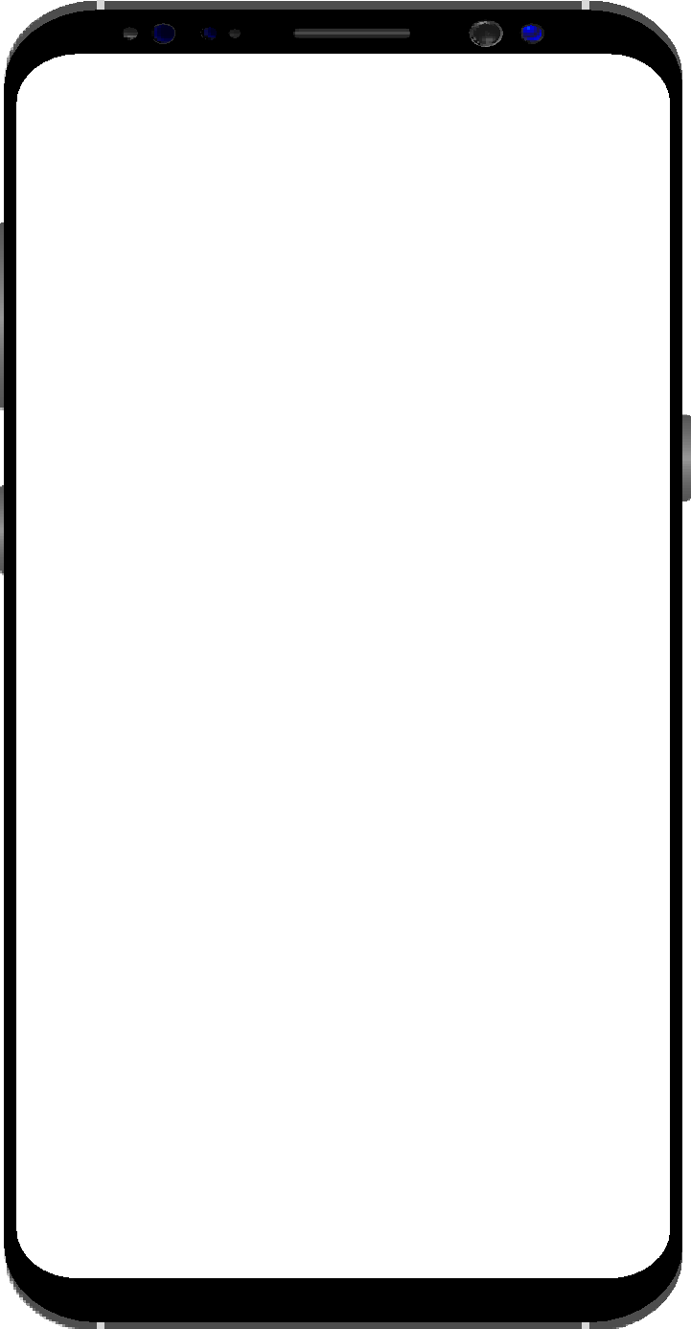



ACROPOLIS INSTITUTE OF TECHNOLOGY
AND RESEARCH
Department of Computer Science and
Information Technology
MAJOR PROJECT PRESENTATION
VII semester
Submitted By::
PRAKHAR JAIN 0827CI191044
SAHAJ MAKWANA 0827CI191049
SNEHAL SINGH SOLANKI 0827CI191056
DR. V
Your Vegi Doctor

Slide 2
OUTLINE
Abstract
Problem Statement
Motivation
Objective and Scope
Project Requirement
Project Idea
Project Category
Project Module Division
Models for Training and Testing
Stakeholder

Slide 3
ABSTRACT
In this online era, where everyone is using online tools for day-to-day activities, there are many problems that a user/farmer is facing as they have currently slow access over online platform and also have to depended on someone else to control their online tools.
They are currently having slow access to identify/detect the disease in plants that they are growing and don’t know how to cure it, so this project uses mobile/web application which will help user to detect and find the solution for a particular vegetable disease using TensorFlow and CNN model.
Therefore, with the help of this project we will help them to detect the disease in the growing plants and cure in early stages with mobile/web application. It helps the user to facilitate easy searching of plants disease and its cure. While using this app any user can use basic functions such as taking the photo of the growing plants, knowing about its disease, finding its cure etc.

Slide 4
Problem Statement
Farmers who grow potatoes suffer from serious financial standpoint losses each year which cause several diseases that affect potato plants. The diseases Early Blight and Late Blight are the most frequent.

Slide 5
Motivation
It is very difficult for farmers to identify various disease in plants.
The estimated annual crop losses due to plant disease at world wide is $60 Billions.
The traditional tools and techniques are not useful since it takes up lots of time and manual work
However with the help of disease detection these difficulties will no longer prevent.

Slide 6
Objective and Scope
Objectives:-
To find the interaction between the disease agents and host plant in relation to overall environment.
To identify various disease in plants.
To implement a method for preventing the disease and providing management for reducing the losses/damages caused by disease
Scope-:
Prevent disease on plants for Farmers.
Help out the pesticide company in predicting the new pesticide solutions.

Slide 7
Project Requirement
Software Used:
a) Model Building :TensorFlow and CNN.
b) Backend : tf serving.
c) Frontend: React JS .
Hardware: Windows OS
Ram: 4GB
CPU: i5

Slide 8

Project Idea

Slide 9
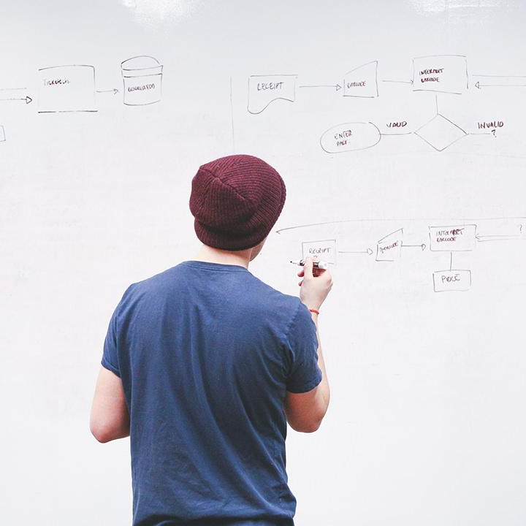
Project Idea
A mobile/web application which will help user to detect and find the solution for a particular vegetable disease.

Slide 10
Project Category
Mobile/Web Application Based
Machine Learning /Deep Learning Based

Slide 11
Project Module Division
 | Description of Work | Expected no. of weeks to complete the module
Module One | Data Collecting and Preprocessing | 2 weeks
Module Two | Model Building | 1 month
Module Three | Web/Mobile App Building | 2 months

Slide 12
Models for Training and Testing
Model used -: CNN (convolutional Neural Network)
A convolutional neural network (CNN or ConvNet) is a network architecture for deep learning that learns directly from data.
CNNs are particularly useful for finding patterns in images to recognize objects, classes, and categories. They can also be quite effective for classifying audio, time-series, and signal data.

Slide 13
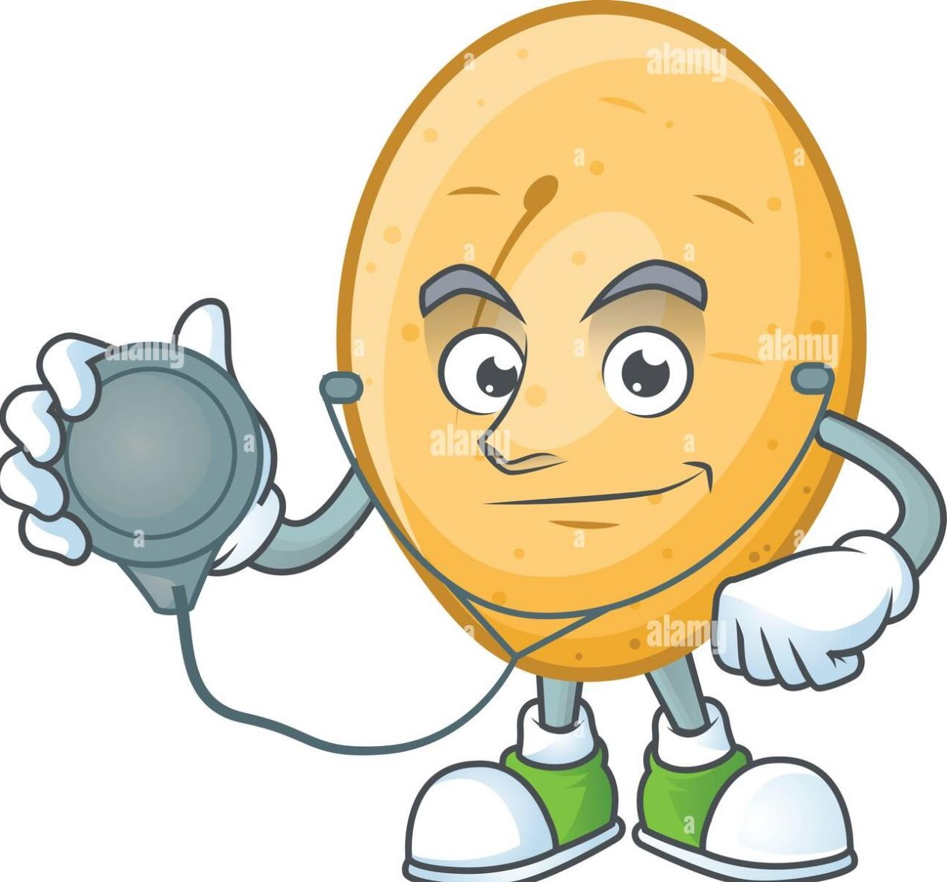
Stakeholder
Farmers
Medical Students
Anyone Interested to know about disease.

Slide 14
THANKS!
Any questions?

